Slide 1

Welcome to Year 2
Class Teacher | Miss Yeomans
Class name | Oak Class
Support Staff | Mrs Styles & Miss Harper
Notes:
Add class names and teacher names
Welcome to our Year X parent presentation. This is an opportunity for you to get to know me a little better and to understand what the year ahead looks like for your child. There will be a lot of information and the slide deck will be emailed to all parents by the end of this week for future reference. Please do ask any questions you might have either during the session or at the end.

Slide 2

As you will be aware we introduced our updated vision and values for Newlands in the Spring Term. This vision is aspirational and we are continuing to develop this culture across the school.
The vision for Newlands is built on belonging, where everyone is accepted for who they are and welcomed, where children feel safe and part of our community. This belonging gives the children the strong roots they need to begin their learning journey with us.
Throughout their time with us, the children grow and learn, becoming stronger and taller just like the trunk of the tree. Learning is not always easy and, just like the twists and bends in this trunk, there are challenges to overcome, but through our shared belonging community and core values we support each other through this journey.
The foliage of the tree represents the future and our children flourishing both academically and emotionally because of the strong foundations they have built during their time with us.
Our core values, Kindness, Respect, Safety, Responsibility, Resilience and Teamwork are embedded in all areas of the curriculum and our day-to-day practice, coming together to support our vision.
Together we belong, together we grow, together we achieve.
Notes:
“A school is built on its vision and values - Emphasise first paragraph, explain vision briefly in own words rather than reading form the slide.”

Slide 3
Newlands Primary School Home School Agreement
School | Parent | Child
The school will do its best to: Provide a secure, happy and stimulating learning environment. Provide a broad and balanced curriculum which meets the needs of your child’s well-being, mental health and academic needs. Encourage your child to show friendship and respect for others and to abide by the school behaviour policy, ensuring a safe and caring environment for all. Teach your child to develop a positive attitude towards one another, regardless of gender, race, culture, belief, age or need. Keep you informed termly about your child’s progress and behaviour, as well as their yearly curriculum. Set regular and appropriate home learning for your child. Make you feel welcome whenever you visit the school and respond to your questions or concerns. Allow children safe and secure use of the Internet through a combination of site filtering, supervision and by fostering a responsible attitude in all pupils, in partnership with parents. (Refer to E-Safety Policy) Communicate promptly in the event of an emergency or other cause for concern Keep you informed about school events, activities, through monthly newsletters, emails and school website. Encourage your child to become an active member within our community and help them see that they can have an impact on the world around them. Encourage your child to feel proud of their achievements and enjoy being a valued member of our school community | All parents and guardians will: Accept the school’s aims and values, positively supporting the school. Ensure that your child attends school punctually every day during term time, arriving in their classroom between 8.30-8.45am. Follow the protocols for safe parking on and outside the school site. Notify the school by letter or telephone in the event of absence by 8.50am on the day of absence. Support the school’s policies and guidelines on learning, behaviour uniform and dress code, both in school and at home. Attend parent/teacher meetings to discuss your child’s progress. Support your child with home learning that is set, including mental maths, spellings, daily reading and keeping the reading record up to date. Keep us informed of any changes to parent / carer and emergency contact details. Promptly inform the school of any concerns or problems. Support the school in the teaching of safe, secure and age appropriate internet use at home. Respectfully follow good practices when using social media to discuss school matters and use formal channels as appropriate. Follow the school photo policy when sharing pictures on social media. Do not take family holidays during term time | I will do my best to: Be a friend to others to help us succeed together as a team Be determined to do all classwork and home learning as well as I can, asking questions when I don’t understand. Be respectful towards other people’s culture, race, feelings and beliefs Accept responsibility for the things I do. Make sure I behave in a way that keeps myself and others safe. Wear my school uniform and look smart. Take care of the building, equipment and grounds. Be kind, helpful and forgiving and honest. Use the Internet safely as I have been taught in class.
Notes:
This is the home school agreement which outlines the responsibilities we all agree to uphold. Learning is a partnership with yourselves, us and your children. We will give you a few minutes to have a look at this so you can see how we all work together to support learning and development.

Slide 4
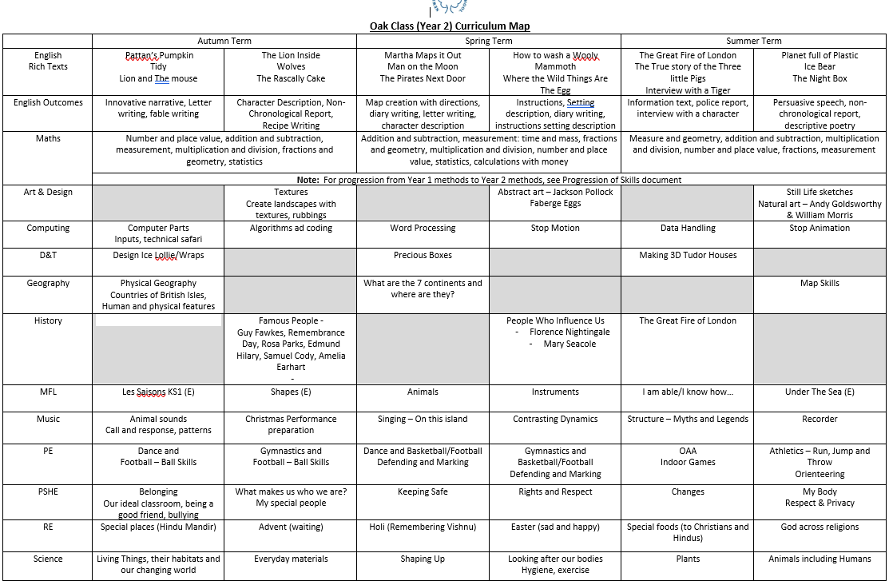
Notes:
Introduce the overview of the year, talk briefly over the topics being covered and mention any enrichment or other lessons that will be occurring e.g. guitar lessons, trips (possible costs), swimming etc.

Slide 5
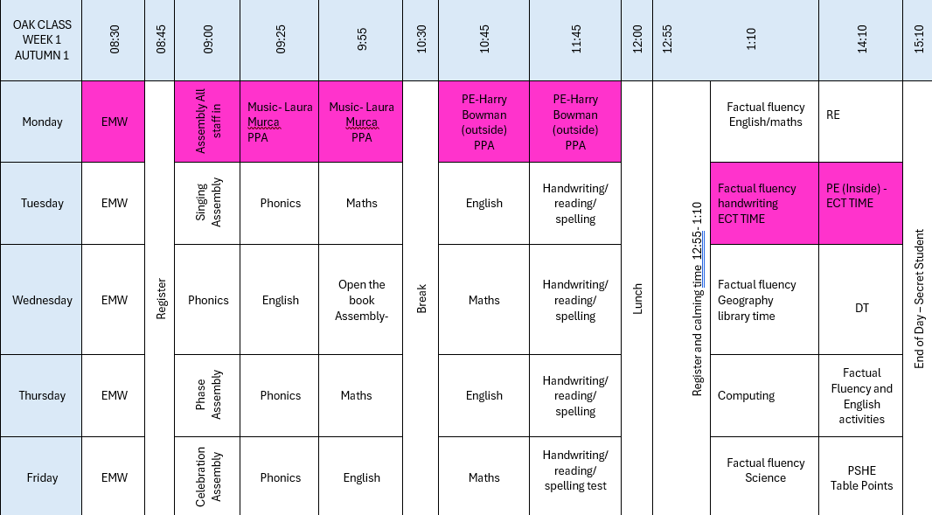
Notes:
This is an example of our weekly timetable. You can see just how busy we are each week! This is a good time to mention attendance, the lessons over the week and term build on each other, and with daily lessons in English and Maths even 1 days absence can have a significant impact on a child’s learning journey in that area. We obviously work in school to support children with the learning they have missed however it is not always possible to entirely recreate the learning opportunities for those who have not been in school.

Slide 6

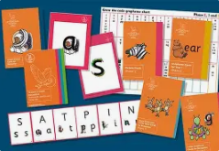
Phonics
We use Little Wandle Letters and Sounds Revised as our chosen systematic phonics programme.
https://www.littlewandle.org.uk/
As part of phonics, the children will read to an adult three times a week.

Slide 7

Phonics
Newlands has subscribed to Collins ebooks.
Login to Collins ebooks on the parent section of Little Wandle on:
https://www.littlewandle.org.uk/resources/for-parents/
Your child will read in school, but please also encourage your child to read these books at home and utilise the public libraries.

Slide 8
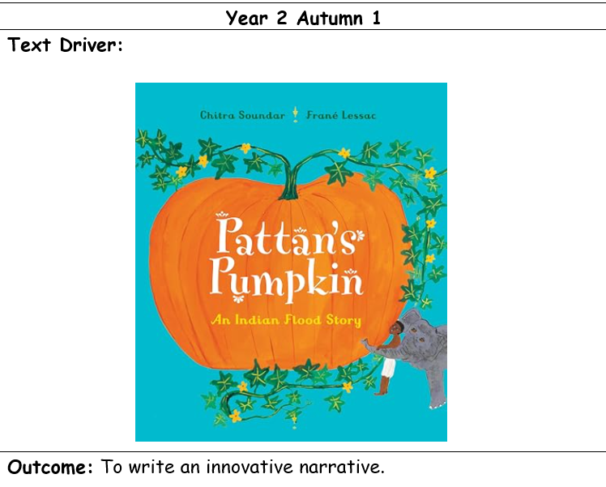




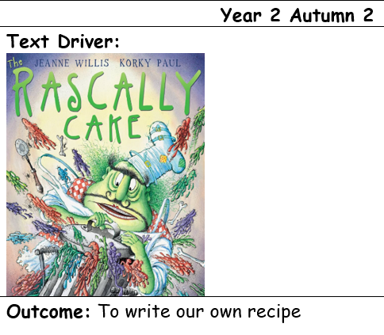

Slide 9
End of year expectations for year 2 English:
Read most common exception words automatically.
Read accurately and fluently using phonics knowledge.
Self-correct when something does not make sense.
Answer questions about what they have read.
Make simple predictions about a story.
Discuss favourite books, characters and authors.
Explain the meaning of new vocabulary in context.
Retrieve information from fiction and non-fiction texts.
Read aloud with expression and appropriate pace.
Write for different purposes, including stories, recounts, instructions and simple reports.
Write sentences that are grammatically correct.
Use capital letters, full stops, question marks and exclamation marks accurately.
Use expanded noun phrases (e.g. the fluffy brown rabbit).Use conjunctions such as and, but, because, when, if.
Spell most Year 1 and Year 2 common exception words correctly.
Use apostrophes for possession and contraction.
Form lower-case and capital letters correctly and consistently.

Slide 10
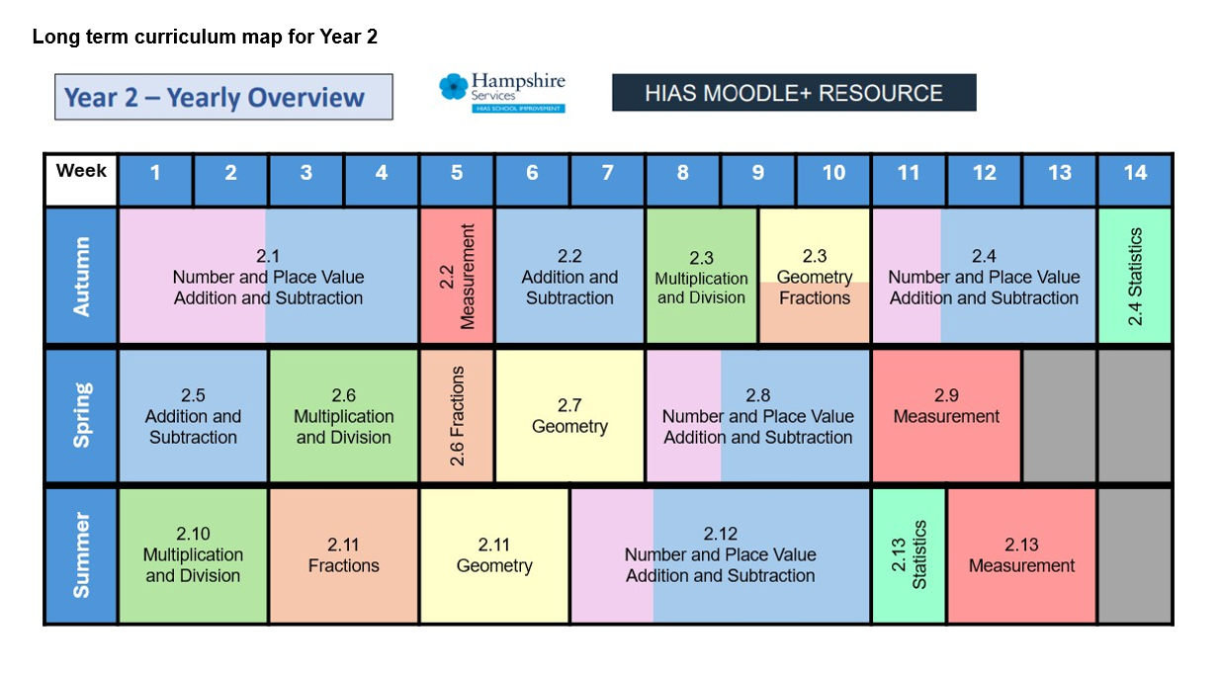

Slide 11
Maths
All children have been given a login to ANTON which is where their weekly maths home learning is set.
The children will also be participating in daily factual fluency lessons to help with their confidence in number skills e.g. number bonds
Some examples of resources we use in class to aid the childrens learning are: counters, tens frames, dienes, number lines, rekenraks, analogue clocks.
Some examples of methods we use in maths that can help your children at home are: part-whole models, tens frames, number lines, 100 squares.

Slide 12
End of year expectations for year 2 maths:
Count forwards and backwards to at least 100.
Count in 2s, 3s, 5s and 10s.
Recognise the place value of each digit in a two-digit number.
Compare and order numbers to 100.
Recall number bonds to 20 fluently.
Add and subtract two-digit numbers.
Solve one-step and two-step problems involving addition and subtraction.
Use inverse operations to check answers
Recall and use the 2, 5 and 10 times tables.
Solve multiplication and division problems using practical resources and drawings
Recognise odd and even numbers.
Find and recognise 1/2, 1/3, 1/4, 2/4 and 3/4 of shapes, objects and quantities.
Understand that two quarters are equivalent to one half

Slide 13
How to help at home
Make sure your children arrive at school: on time, well rested, fed and ready for a day of learning.
Encourage learning of number bonds and times tables and use real life examples to support this, for example when shopping or preparing meals.
Talk with your children about their home learning and support them where appropriate encouraging them to take the lead.
Limit screen time use to support cognitive development and emotional resilience
Take time to play and relax with your children. We work them hard during the day and time to play and be together is one of most invaluable learning opportunities you can provide.
Notes:
Home learning is on the website! Possible activities for you to choose from inc reading, maths, spellings (when we go onto this) and humanities.

Slide 14
General Information, Equipment and Resources
Ensure that children are wearing the correct school or PE uniform following the policy.
Bring a water bottles everyday.
Reading books and records in home folder daily.
Spelling day: Friday
PE days: Monday and Tuesday (Please wear full P.E. uniform to school following the policy)
Please try to avoid large bags – a book bag should be sufficient.
Pencil cases are not required as all equipment is provided, any pencil cases need to be able to fit in a tray.
Class Webpages
Home Learning
Items from home
Notes:
Amend to reflect your P.E. and spelling days above
Items from home should not be brought into school this includes fidget toys unless they have been agreed as part of a school support programme.
WATERPROOF COATS needed everyday!!!!!

Slide 15
Other Information
Attendance
Remember, Reception – Year 2 benefit from free meals. This will need to be ordered at home in advance.
Snack time – should be fresh fruit or vegetables only - nothing in in a wrapper! This is also provided Reception – Year 2.
Please no glass water bottles or food containers.
Please name everything
We are a nut-free school, please check ingredients lists of food and do not send in items containing nuts.
Please ensure you have updated the school office with the most current details and provided us with medication via the office.
If children are to be picked up by a different adult, we can only release them with prior notification to the school office.
Notes:
KS2 remove first point

Slide 16

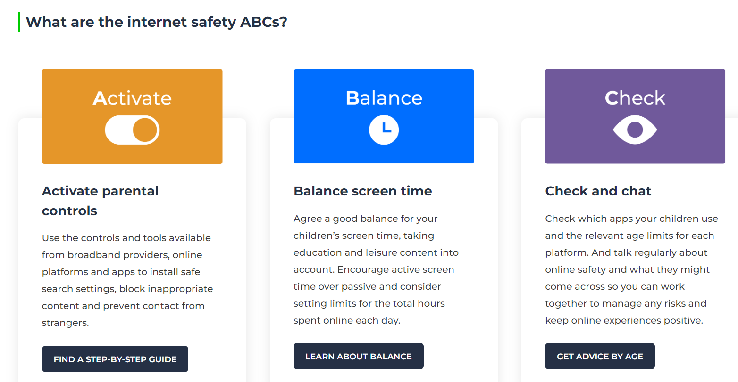


Keeping your child safe online
https://www.newlandsprimary.net/page/?title=Online+Safety&pid=84

Slide 17
How to contact me ☺
Please contact teachers via the school office either in person, by telephone or email.
Please provide a short context to the request when emailing the office or leaving a message as this will help me plan out time to contact you, and prepare any information in advance.
Your response will be acknowledged by the office on receipt and a member of the school team will contact you within 48 hours (M-F term time only)
01252 871188 enquiries@newlands.hants.sch.uk
Notes:
Explain importance of contacting via secretary so can ensure messages don’t get missed due to staff absence from illness or on training courses.

Slide 18
Any questions?
Thank you
☺

